Slide 1
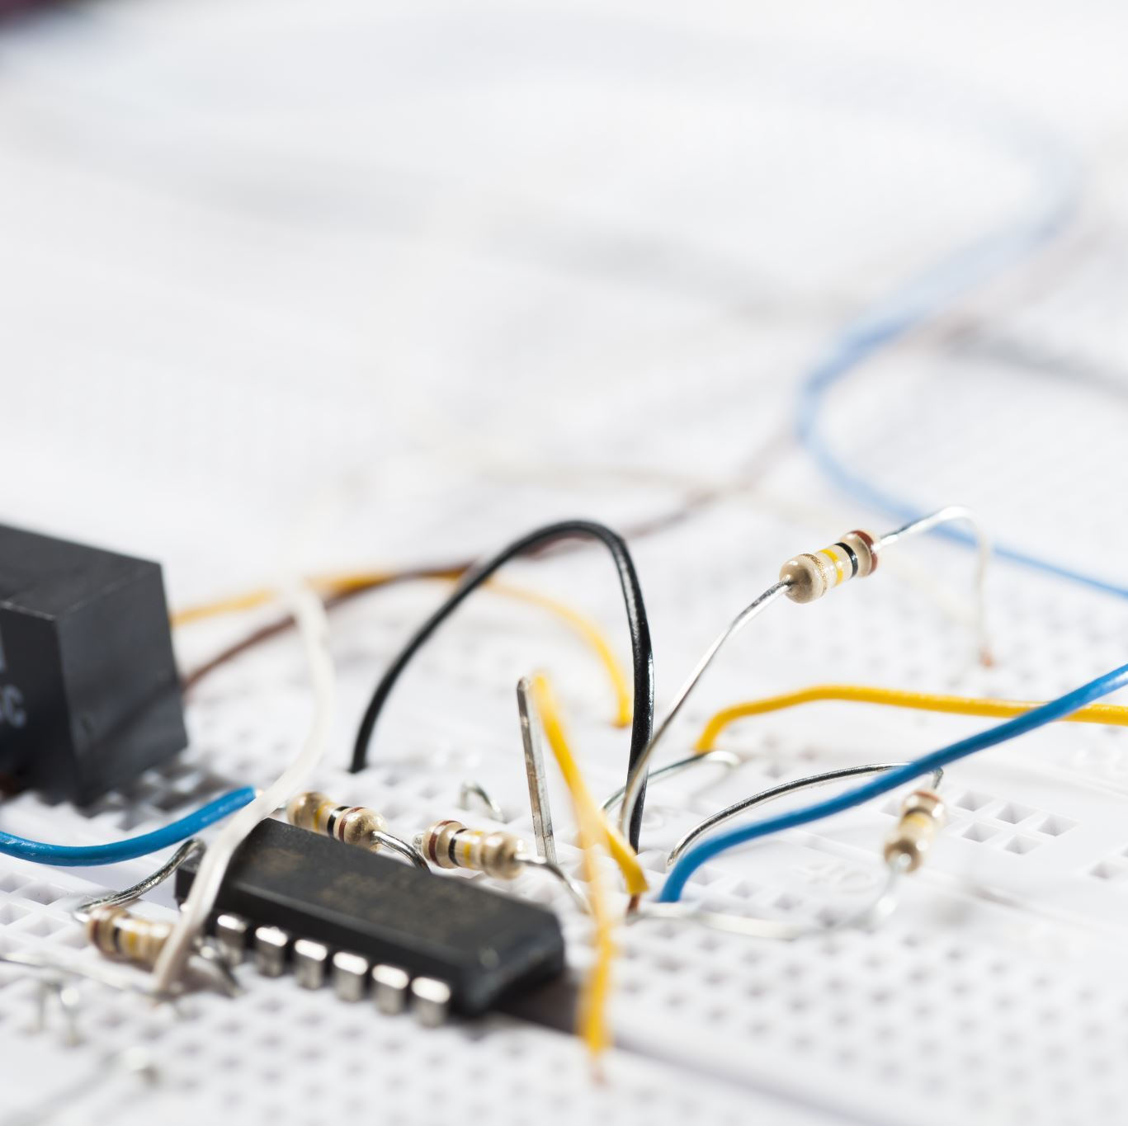
Clipper Circuit

Slide 2
Definition
Clippers are networks that employ diodes to “clip” away a portion of an input signal without distorting the remaining part of the applied waveform.

Slide 3
Classification
Series Clipper
Parallel Clipper

Slide 4
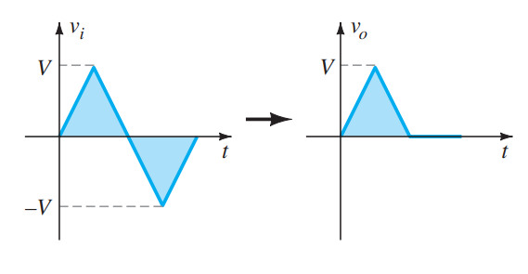
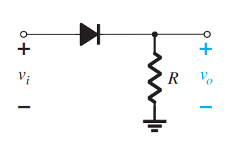
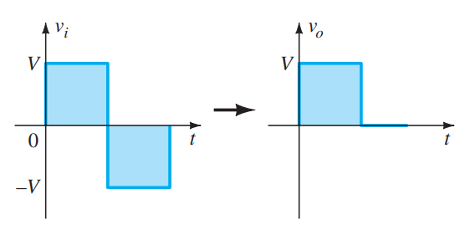
Series Clipper

Slide 5
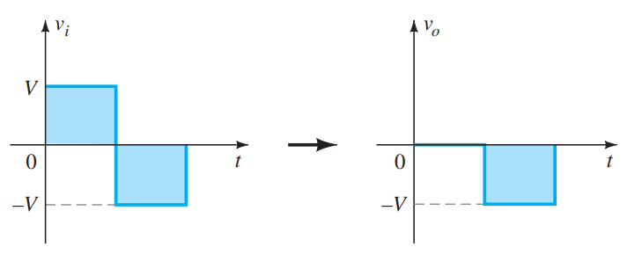
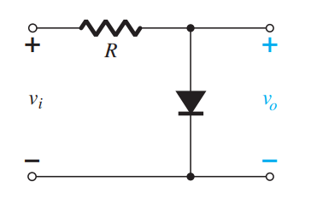
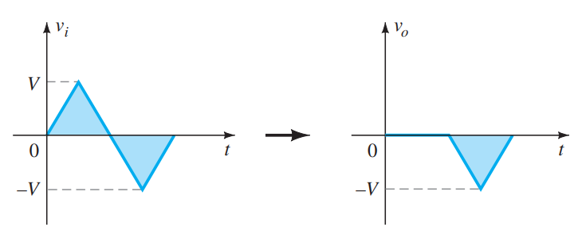
Parallel Clipper

Slide 6
Procedure
1. Take careful note of where the output voltage is defined.
1
2. Try to develop an overall sense of the response by simply noting the “pressure” established by each supply and the effect it will have on the conventional current direction through the diode.
2
3. Determine the applied voltage (transition voltage) that will result in a change of state for the diode from the “off” to the “on” state.
3

Slide 7
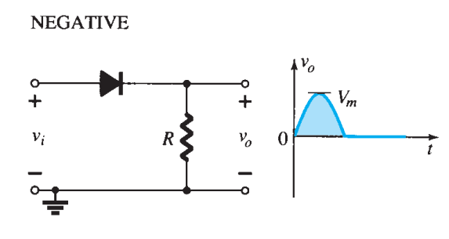
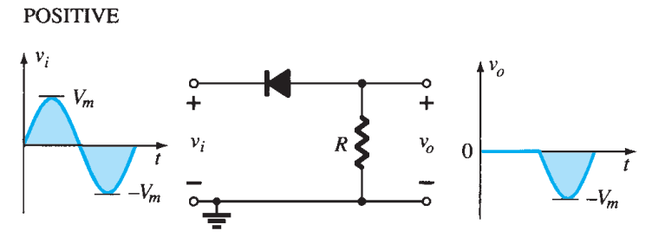
Simple Series Clipper(Ideal Diode)

Slide 8
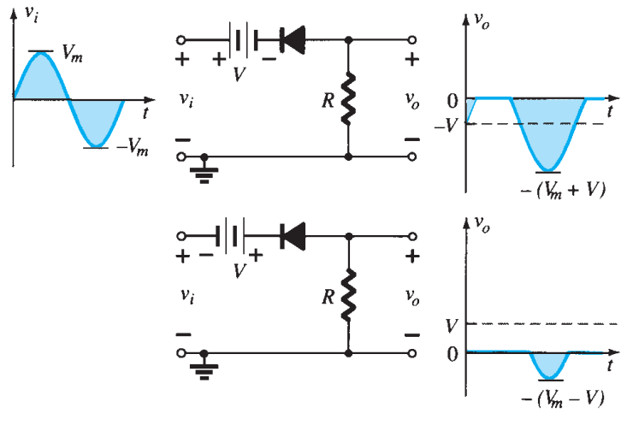
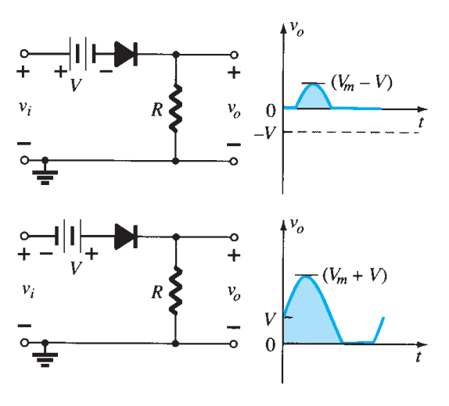
Biased Series Clipper(Ideal Diode)

Slide 9
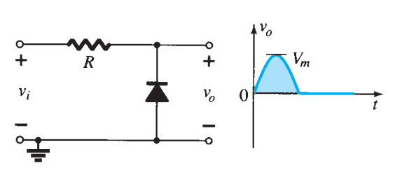
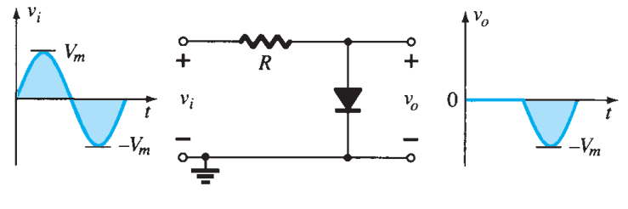
Simple Parallel Clipper(Ideal Diode)

Slide 10
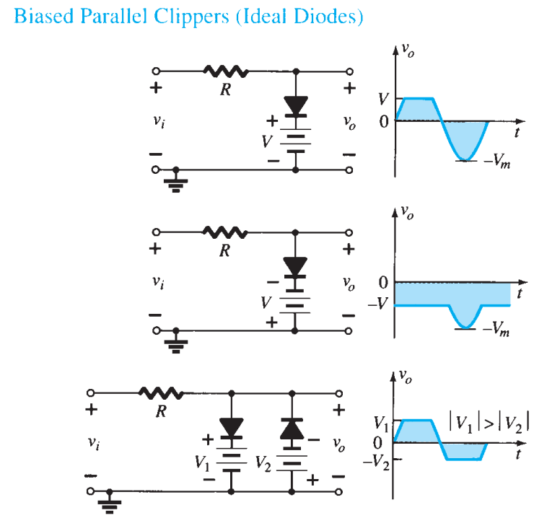
Biased Parallel Clipper(Ideal Diode)

Slide 11
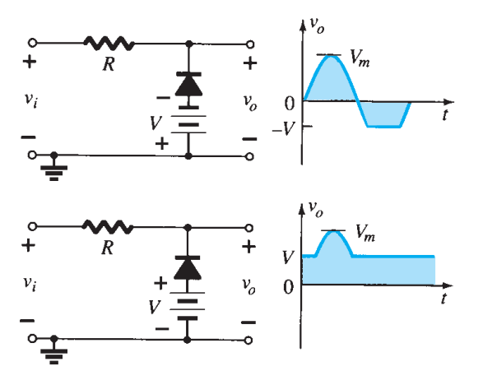
Biased Parallel Clipper(Ideal Diode)

Slide 12
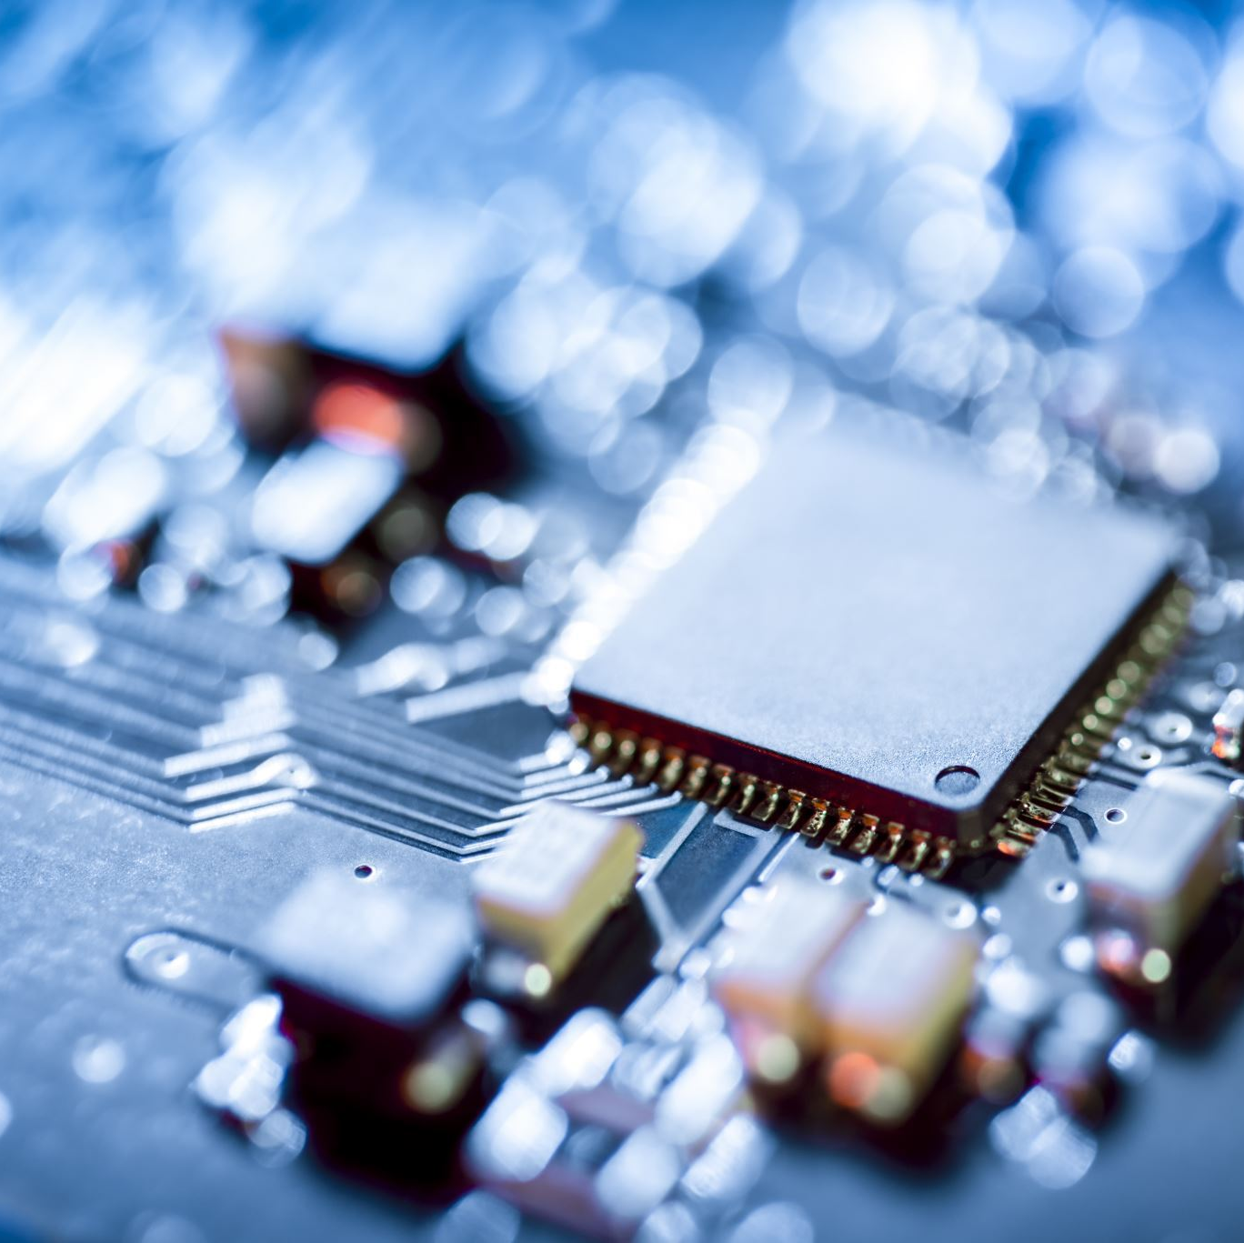
Clamper Circuit

Slide 13
Definition
A clamper is a network constructed of a diode, a resistor, and a capacitor that shifts a waveform to a different dc level without changing the appearance of the applied signal.
Clamping networks have a capacitor connected directly from input to output with a resistive element in parallel with the output signal. The diode is also in parallel with the output signal but may or may not have a series dc supply as an added element.

Slide 14
Procedure
Step 1: Start the analysis by examining the response of the portion of the input signal that will forward bias the diode.
Step 2: During the period that the diode is in the “on” state, assume that the capacitor will charge up instantaneously to a voltage level determined by the surrounding network.
Step 3: Assume that during the period when the diode is in the “off” state the capacitor holds on to its established voltage level.
Step 4: Throughout the analysis, maintain a continual awareness of the location and defined polarity for v o to ensure that the proper levels are obtained.
Step 5: Check that the total swing of the output matches that of the input.

Slide 15
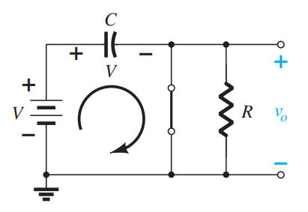
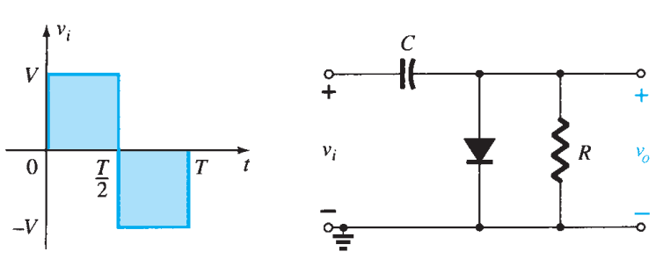
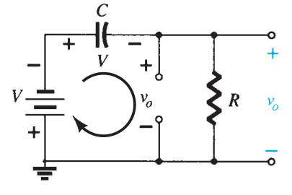
Clamping Network

Slide 16
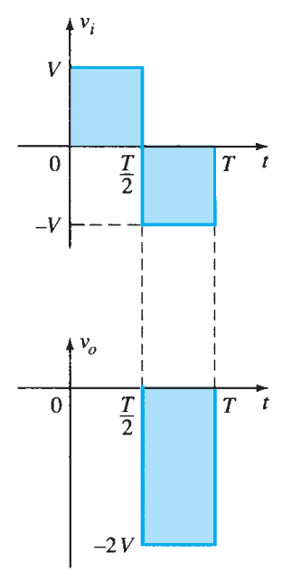
Clamping Network

Slide 17
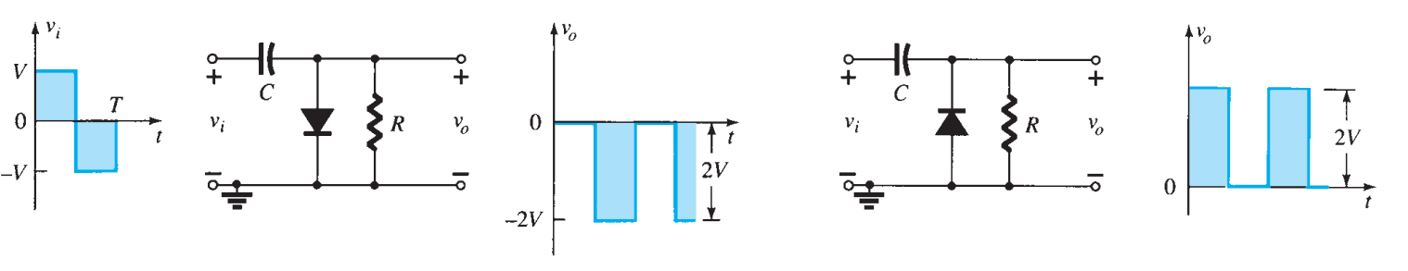
Clamping Network

Slide 18
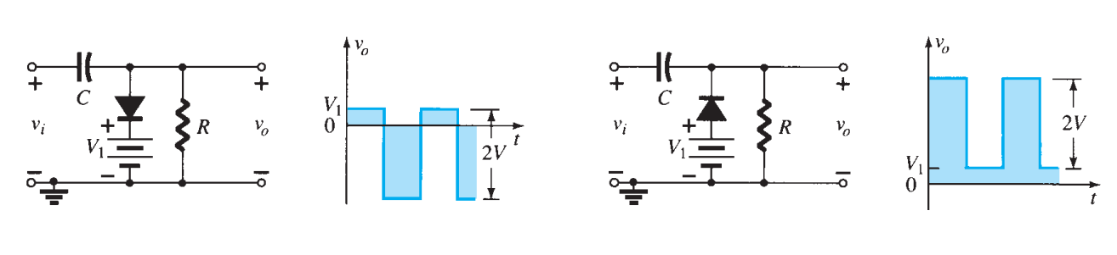
Clamping Network

Slide 19
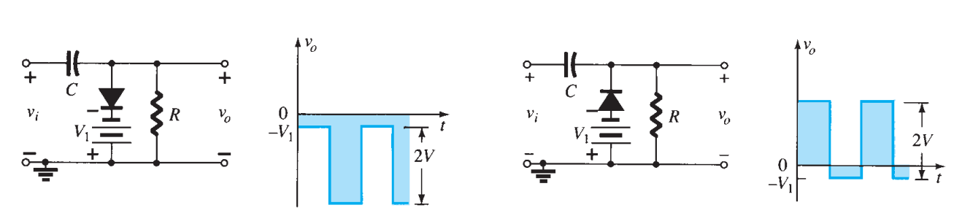
Clamping Network

Slide 20
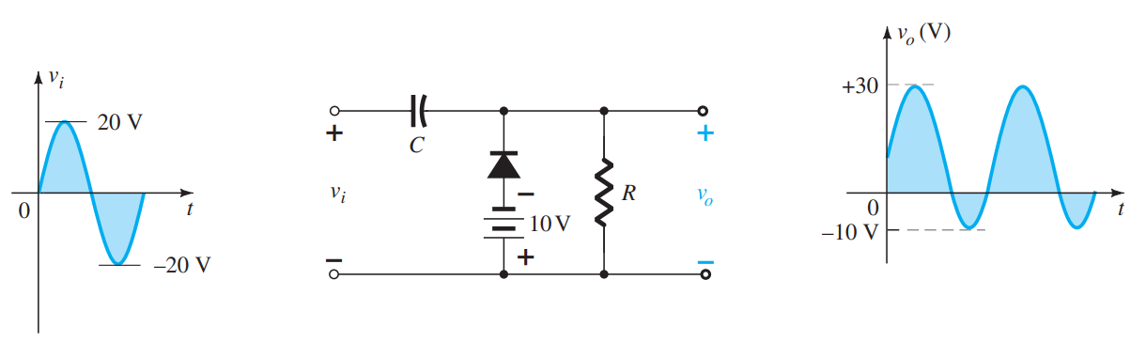
Clamping Network

